Slide 1
TCC Project testing process

Slide 2
Development workflow and testing process
Estimation
Development
System Pre-release testing
Acceptance testing

Slide 3
Testing activities on the TCC project
Specifications reviews.
Estimation time, required for new features testing.
Test design: test plans, test scripts.
All levels of testing: component, integration, system, acceptance.
Most of the testing types: functional, non-functional, regression testing.

Slide 4
Tools, that are used by ISSART testers
Test link application as the tests management tool.
Apache J-meter, as the tool for execution performance testing tasks and partly for functional testing: generation data required for testing and testing on the API level.
Developer tools for browsers: Grome-bug, httpfox, firebug, cache manager, firecookie.

Slide 5
Testing activities during the estimation phase
Test requirements and specifications.
Communication with developers on specific details.
Creation of the test plan.
Estimation time, required for testing.

Slide 6
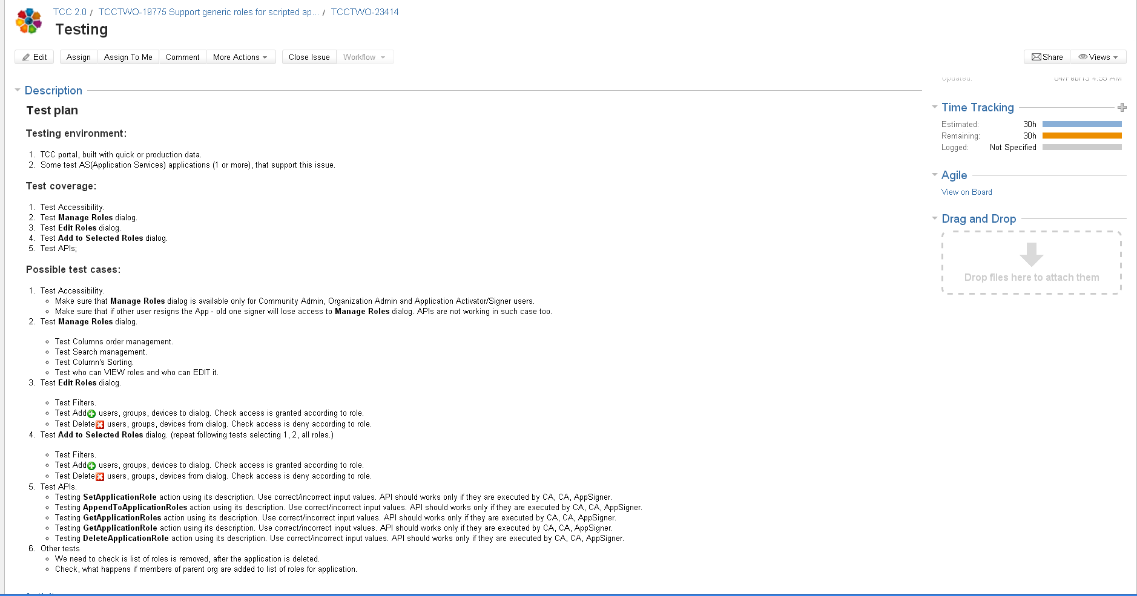
Live example from TCC JIRA of test plan

Slide 7
Testing activities during the development phase
Testing implemented features.
Testing bugs fixed for the release.
Test design: creating test scripts for the implemented features.
Test design: updating test scripts for the fixed bugs.
Creating J-meter scripts and executing them for the features, that are critical in performance term.
Testing localization.
Testing TCC documentation.
Exploratory testing.

Slide 8
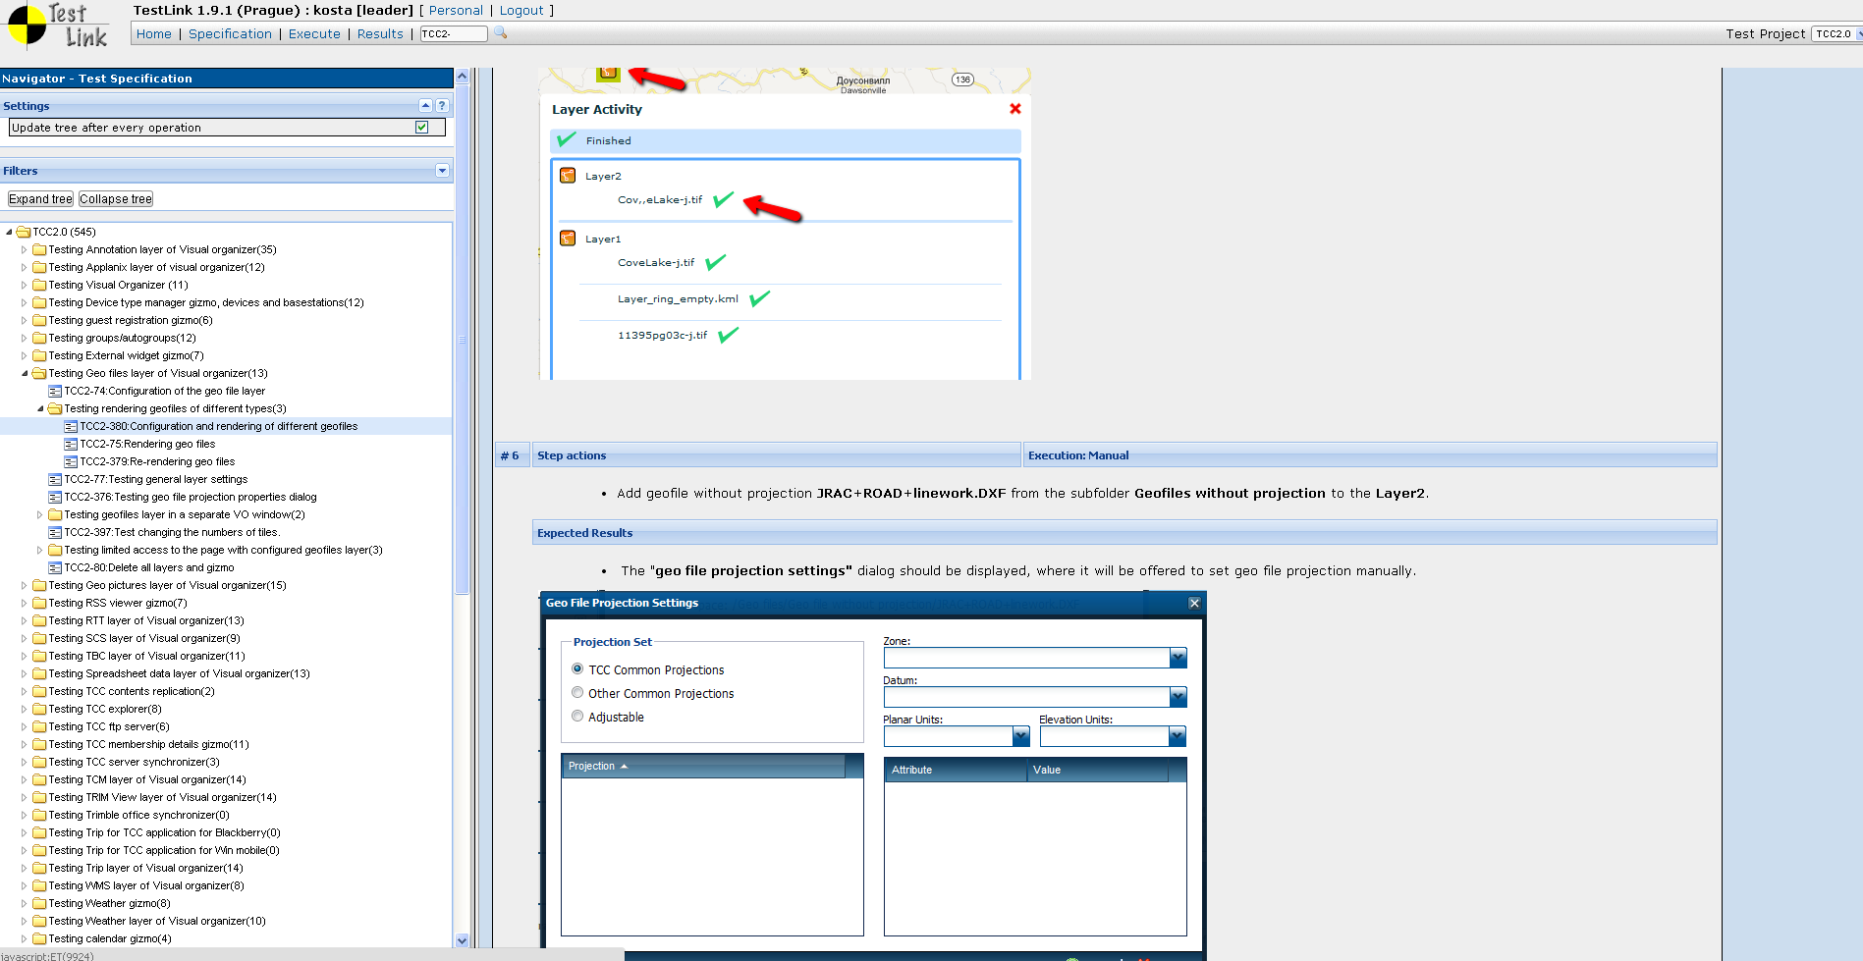
Test scripts organization in the test link

Slide 9
Test activities during the regression testing phase
Regression testing.
System testing.
Release bugs testing.
Bugs opening and verification.
Retesting implemented features and fixed bugs for the release.
Retesting release bugs.
Performance tests execution.
Estimation system readiness for the release.

Slide 10
Test data organization details
The similar set of organizations, login accounts, groups, sites, pages, filespaces, permission assignments for quick and production data.
The preconfigured set of sites, pages and filespaces for quick data and in the production data, with assigned permissions.
Set of sites and pages with configured gizmos, used for sanity checks.

Slide 11
Test activities during and after roll out
Sanity check of the system.
Information email to customers about roll out results.
Review test execution results.

Slide 12
ISSART Test team
Konstantin Firsanov – team lead.
Alexander Malyshkin
Tatyana Butakova
Olga Ippolitova
Ilya Demchenko
Oksana Kuzmina
Galina Ankilova
Valentine Gusev

